Slide 1
BAT: Deep Learning Methods on Network Intrusion Detection Using NSL-KDD Dataset A

Slide 2
ABSTRACT
Intrusion detection can identify unknown attacks from network traffics and has been an effective means of network security.
Nowadays, existing methods for network anomaly detection are usually based on traditional machine learning models, such as KNN, SVM, etc.
Although these methods can obtain some outstanding features, they get a relatively low accuracy and rely heavily on manual design of traffic features, which has been obsolete in the age of big data. To solve the problems of low accuracy and feature engineering in intrusion detection, a traffic anomaly detection model BAT is proposed. The BAT model combines LINEAR REGRESSION, 3 LAYER NEURAL NETWORK and attention mechanism.
Attention mechanism is used to screen the network flow vector composed of packet vectors generated by the 3-layer DNN model, which can obtain the key features for network traffic classification. In addition, we adopt multiple convolutional layers to capture the local features of traffic data.

Slide 3
PROBLEM STATEMENT
Intrusion detection plays an important part in ensuring network information security. However, with the explosive growth of Internet business, traffic types in the network are increasing day by day, and network behaviour characteristics are becoming increasingly complex, which brings great challenges to intrusion detection .
How to identify various malicious network traffics, especially unexpected malicious network traffics, is a key problem that cannot be avoided.

Slide 4
OBJECTIVE
Intrusion detection can be considered as a classification problem. By improving the performance of classifiers in effectively identifying malicious traffics, intrusion detection accuracy can be largely improved. Machine learning methods have been widely used in intrusion detection to identify malicious traffic.
However, these methods belong to shallow learning and often emphasize feature engineering and selection. They have difficulty in features selection and cannot effectively solve the massive intrusion data classification problem.

Slide 5
EXISTING SYSTEM
In existing methods analysis of the viability of Recurrent Neural Networks (RNN) to detect the behavior of network traffic by modeling it as a sequence of states that change over time.
In existing methods verify the performance of Long ShortTerm memory (LSTM) network in classifying intrusion traffics. Experimental results show that LSTM can learn all the attack classes hidden in the training data.

Slide 6
DISADVANTAGES
All the above methods treat the entire network traffic as a whole consisting of a sequence of traffic bytes. They don’t make full use of domain knowledge of network traffics.
Existing methods treats traffics as independent and ignore the internal relations of network traffics.

Slide 7
PROPOSED SYSTEM
We propose an end-to-end deep learning model DNN that is composed of DNN and attention mechanism. DNN can well solve the problem of intrusion detection and provide a new research method for intrusion detection
We compare the performance of DNN with traditional deep learning methods, the BAT-MC model can extract information from each packet. By making full use of the structure information of network traffic, the DNN model can capture features more comprehensively. 4) We evaluate our proposed network with a real NSL-KDD dataset.

Slide 8
HARDWARE REQUIREMENTS:
System : Pentium IV 2.4 GHz.
Hard Disk : 100 GB.
Monitor : 15 VGA Color.
Mouse : Logitech.

Slide 9
SOFTWARE REQUIREMENTS:
Operating system : Windows XP/7/10
Coding Language : Html, JavaScript,
Development Kit : Flask Framework
Database : mysql
IDE : Anaconda prompt
Dataset : NSL-KDD dataset

Slide 10
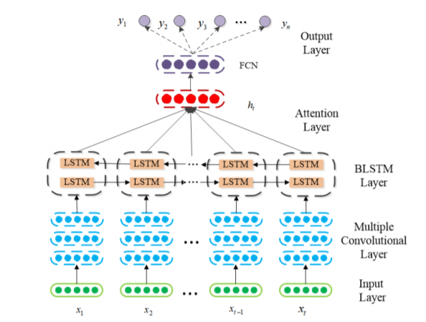
Architecture

Slide 11
REFRANCES
B. B. Zarpelo, R. S Miani, C. T. Kawakani, and S. C. de Alvarenga, ‘‘A survey of intrusion detection in Internet of Things,’’ J. Netw. Comput. Appl., vol. 84, pp. 25–37, Apr. 2017.
[2] B. Mukherjee, L. T. Heberlein, and K. N. Levitt, ‘‘Network intrusion detection,’’ IEEE Netw., vol. 8, no. 3, pp. 26–41, May 1994.
[3] S. Kishorwagh, V. K. Pachghare, and S. R. Kolhe, ‘‘Survey on intrusion detection system using machine learning techniques,’’ Int. J. Control Automat., vol. 78, no. 16, pp. 30–37, Sep. 2013.
[4] N. Sultana, N. Chilamkurti, W. Peng, and R. Alhadad, ‘‘Survey on SDN based network intrusion detection system using machine learning approaches,’’ Peer-to-Peer Netw. Appl., vol. 12, no. 2, pp. 493–501, Mar. 2019.
[5] M. Panda, A. Abraham, S. Das, and M. R. Patra, ‘‘Network intrusion detection system: A machine learning approach,’’ Intell. Decis. Technol., vol. 5, no. 4, pp. 347–356, 2011.

